Slide 1
IPv6 Transition: Let’s make it happen!
16th June, 2011
AP Regional IGF, Singapore
Miwa Fujii
Senior IPv6 Program Specialist
APNIC (www.apnic.net)

Slide 2
Overview
About Internet and APNIC
About Internet Protocol: IPv4 and IPv6
IPv4 addresses exhaustion and need to adopt IPv6
What does this mean to all of us?
Where are we now?
Internet stakeholders and IPv6 transition

Slide 3
About Internet and APNIC
The Internet: a global system of interconnected computer networks
Internet Protocol (IP) provide connectivity
IPv4 and IPv6 = Internet resources
Regional Internet Registries (RIR)
Asia Pacific Network Information Centre (APNIC)
Open membership-based industry bodies
Non-profit, neutral, and independent
Internet resource allocation, registration and other services such as training, supporting infrastructure, community cooperation

Slide 4
Policy Development Process
Need
OPEN
Anyone can participate
Evaluate
Discuss
‘BOTTOM UP’
TRANSPARENT
Implement
Consensus
Internet community proposes and approves policy
All decisions & policies are documented & available

Slide 5
About Internet Protocol (IP)
On the Internet you are nothing but IP addresses
Not same as a domain name
Packets, addressing and routing
Two types: IPv4 and IPv6
Every device directly connected to the Internet needs a unique IP address
IP address space is finite

Slide 6
Recap
Size of IPv4 addresses
32-bit address
Unit to describe a size of IP address space
/ = slash notation
/8 = 2²⁴ = about 16.5 million IPv4 addresses
/16 = 2¹⁶ = about 65,000 IPv4 addresses
/24 = 2⁸ = 256 IPv4 addresses
2³² = about 4.2 billion IP addresses
2³² = 256 x /8 IPv4 address space

Slide 7
IP Addresses: IPv4 vs. IPv6
IPv4 | IPv6
Deployed 1981 | Deployed 1999
32-bit address 192.149.252.76 | 128-bit address 2001:DB8:0234:AB00:0123:4567:8901:ABCD
Address space 2³² = ~4,000,000,000 | Address space 2¹²⁸ = ~340,000,000, 000,000,000,000,000, 000,000,000,000,000
Security, autoconfig, QoS, mobility added later (IPSec etc) | Security, autoconfig, QoS “built-in” (IPSec etc)
Reached the final /8: April 2011 | Projected lifetime: Indefinite
Notes:
7

Slide 8
IPv4 addresses exhaustion and need to adopt IPv6
3 Feb 2011
Number Resource Organization (NRO) announced the free pool of available IPv4 addresses is now fully depleted
The free pool of available IPv4 addresses at APNIC reached the final /8
Need to deploy IPv6
IANA
AfriNIC
APNIC
ARIN
LACNIC
RIPE

Slide 9
Impact of IPv4 address exhaustions
Immediate impact
ISPs will no longer be able to obtain IPv4 addresses from APNIC
Survive for a short time of period with their own pool
Business continuity of ISPs and other Internet multi-stakeholders in question
Need to find alternative source for IPv4 addresses
No sustainable alternative options
Prolonged impact
Difficulties to maintain sustainable Internet growth
No more new entries to the Internet market place
Impediment of further technological development

Slide 10
Why do we need IPv6
IPv6 is the only viable option we have now
Much larger address space than IPv4
Enable sustainable growth of the Internet
Possibilities of emergence of new technologies
More non-computing devices, and mobile devices connecting to the Internet
Ever increasing always on end users using global IP addresses

Slide 11
What does this mean to all of us?
Internet industry is facing a biggest challenge; the biggest since inception of the Internet
Internet multi-stakeholders need to transit to IPv6
To maintain global competitiveness, governments should support industry to deploy IPv6

Slide 12
IPv6 transition technologies
Various IPv6 transition technologies are available
Deciding to “support” IPv6 in a network and completing implementation of specific technologies are two different things
Developing a specific plan, timelines and costs
Assessing the incremental risks and opportunities
One size does not fit all
All Internet multi-stakeholder need to act now
ISPs need to:
Introduce IPv6 into their service portfolio
Introduce additional measures allowing them more efficient use of IPv4 addresses
http://www.potaroo.net/ispcol/2011-02/transtools-part1.pdf
http://www.potaroo.net/ispcol/2011-03/transtools-part2.pdf

Slide 13
IPv6 transition technologies
Complexity generated in the existing IPv4 networks by Network Address Translator (NAT)
Generally pass only TCP and UDP transport protocols
IPv6-in-IPv4 protocol may not pass NATs
How to offer IPv6 connectivity to end hosts in IPv4 NATed network?
Maintaining the same level of robustness and performance as compared to IPv4 services
IPv6 business plan needs to be considered simultaneously while choosing IPv6 transition technologies
http://www.potaroo.net/ispcol/2008-02/tui.pdf
http://www.potaroo.net/ispcol/2011-02/transtools-part1.pdf
http://www.potaroo.net/ispcol/2011-03/transtools-part2.pdf

Slide 14
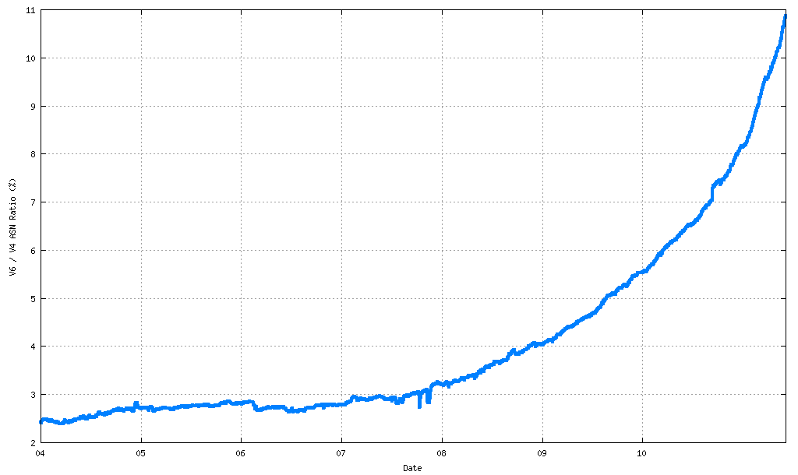
Where are we now?
IPv6 enabled networks
IPv6 / IPv4 AS Count Ratio
http://bgp.potaroo.net/stats/nro/v6/ as of 07/06/2011

Slide 15
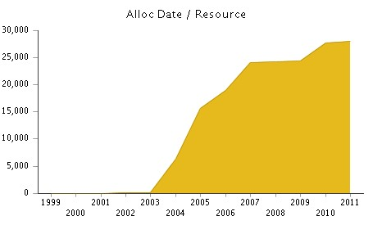
Where are we now?
http://www.apnic.net/publications/research-and-insights/stats/ipv6-distribution as of June 2011

Slide 16
Where are we now?
IPv6 Forum: List of IPv6 enabled ISPs
http://www.ipv6forum.com/ipv6_enabled/isp/approval_list.php
So far 98 are listed, e.g. in the AP region,
Australia: PPS Internet
China: China Telecom, China Unicom
Chinese Taipei: Chunghwa Telecom HiNet
Indonesia: D-NET, DTPNet
Japan: Avis, NTT, IIJ, FreeBit, Dream Train
Thailand: ThaiSam
Malaysia: Jaring Communications
More ISPs with IPv6 though not listed in the IPv6 Forum site

Slide 17
Where are we now?
CDN and Content providers
CDN: Akamai
Finally CDNs are getting ready with IPv6
Q1 2011: IPv6 service for selected customers
2H 2011: Beta services for IPv6 end users
1H 2012: With limited availability
Avoid Carrier Grade Nat (CGN), tunnels, indirect routes, and other performance reliability bottlenecks
Content providers
Google: Most Google services are IPv6 enabled
Facebook: Experimenting IPv6 (non-production yet) (www.v6.facebook.com, etc.)
Etc.
http://www.apricot-apan.asia/program/ipv6-trans-conf

Slide 18
Internet stakeholders
Governments
Promote public and private sectors cooperation
Define IPv6 mandatory standard for government procurements
Deploy IPv6 government infrastructure
ISPs
Deploy IPv6 in their production networks and provide IPv6 connectivity services to their customers
Equipment vendors
Introduce IPv6 support into your product cycle, listen to your customers’ request to improve IPv6 functionalities of your equipment
Application developers
Confirm existing applications’ coding can handle IPv6 data and develop new applications with IPv6 capability
Content providers and CDN
Enable IPv6 reachability for your content
CDN to provide IPv6 enable content distribution services

Slide 19
Preparing for IPv6 Transition
Overall planning
Review the impact of IPv4 address exhaustion
Inventory of your IT assets
Develop an IPv6 deployment plan
Strategy, scope of the deployment, schedule, auditing of execution of the plan
How to manage coexistence of IPv4 and IPv6
Where to start to deploying IPv6?
What transition techniques to be employed?
Staff training
Budget readiness

Slide 20
Preparing for IPv6 Transition
Technical management
Assess the possibility of IPv4 and IPv6 co-existence with desired technology
There are quite a few transition technologies are available
Assess security implication of IPv6
Any new technology comes with new security threats and vulnerabilities
Human capacity development
Develop a plan to acquire skills to implement IPv6
Implement a test networks with IPv6

Slide 21
How APNIC can Contribute
Provide “IPv6 Workshops” in collaboration with regional organizations
Provide information to policy makers, regulators and CIOs in your economy
Round table discussions
APNIC eLearning IPv6 modules are open to anyone
Contribute to your multi-stakeholder outreach efforts
Regional conferences

Slide 22
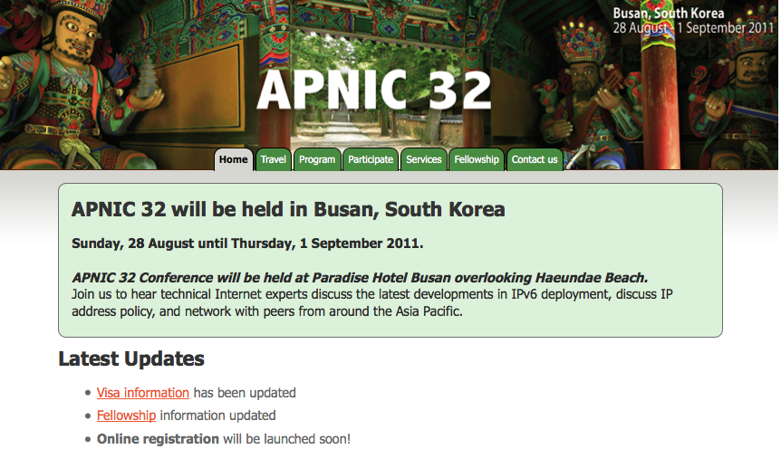
Next APNIC Meeting APNIC 32
Participation is open to anyone in the
Internet community.
Join us!

Slide 23
IPv6 Transition Plenary 30th Aug 2011

Slide 24
IPv6: A prerequisite to the sustainable long-term development of a ubiquitous and open Internet Thank you! <miwa@apnic.net>

